Slide 1
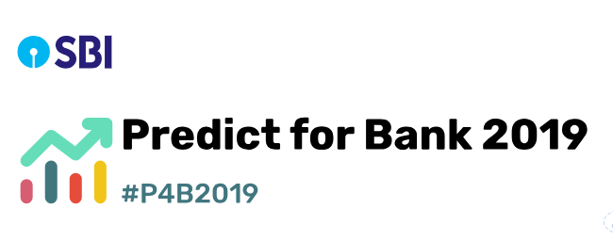
Predicting corporate loan default
AKSHAR SHARMA, HARSHIT SINGH, Simran jain

Slide 2
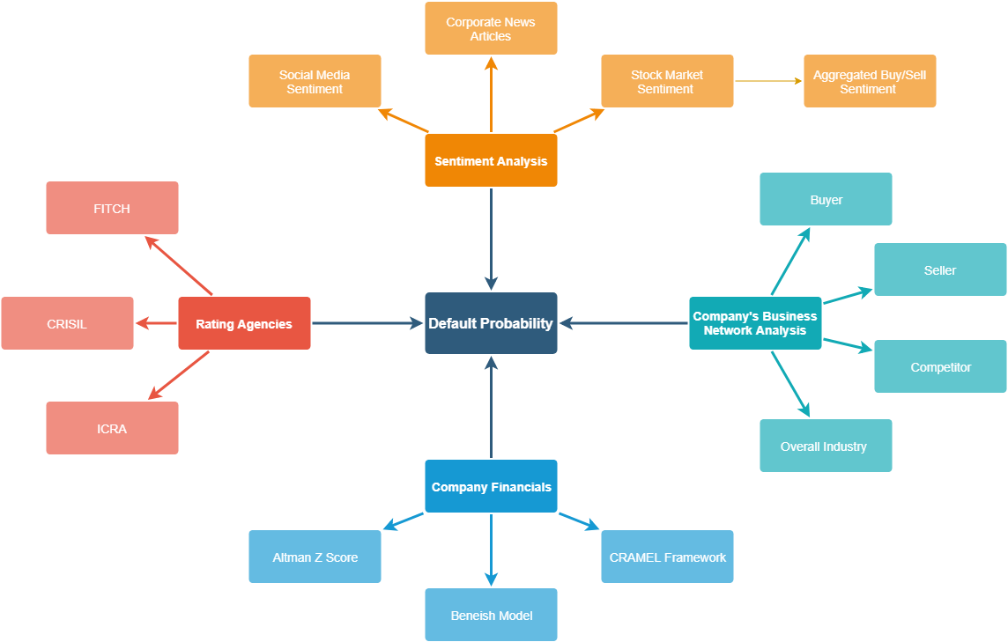
Model

Slide 3
Sentiment analysis
Sentiment Analysis
Social Media
Stock Market
News Article
The use of Natural Language Processing (NLP), text analysis, and computational linguistics to systematically identify, extract, quantify, and study affective states and subjective information.
Purpose : Social media can be one of the fastest source of news, and activities that are taking place at a particular location, or pertaining to particular organisation. Analysing the social media and credible sources of news can reveal great insights about a company’s perception by the people, and the peoples’ reaction to any current happening related to the company, thus proving itself to be a great source to predict corporate loan default. Such an event, or even feelers about the event will trigger widespread opinion shift in the media, which can be a key indicator in predicting a possible default.

Slide 4
Sentiment analysis – social media
Methodology
Scrape the social media data from sites like Twitter, from the desired company’s account, hashtags, and people’s interaction with them.
Refine search by using keywords like Loan, Default, Scam, etc.
Clear all the HTML and text that is not required, keeping only the news content for analysis.
Apply SentimentIntensityAnalyzer from NLTK’s sentiment.vader, to obtain sentiment scores of social media posts.
Analyse the posts’ sentiment score : intensity and polarity, and look for a change in overall opinion over time.
A high negative polarity score, that starts to continue overtime, could be a possible indicator.
Language of choice : Python 3.0
Libraries : NLTK, BeautifulSoup

Slide 5
Sentiment analysis – News articles
Methodology
Scrape the corporate news articles from sites like BusinessTimes, etc. for the desired company.
Refine search by using keywords like Loan, Default, Scam, etc.
Clear all the HTML and text that is not required, keeping only the news content for analysis.
Apply SentimentIntensityAnalyzer from NLTK’s sentiment.vader, to obtain sentiment scores of social media posts.
Analyse the posts’ sentiment score : intensity and polarity, and look for a change in overall opinion over time.
A high negative polarity score, that starts to continue overtime, could be a possible indicator.
Language of choice : Python 3.0
Libraries : NLTK, BeautifulSoup

Slide 6
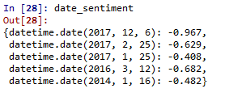
Sentiment analysis – News articles (Contd.)
Adjoining figure is a sample output when searching for articles related to Vijay Mallya’s Kingfisher, which has defaulted on corporate loans. Such sentiment scores can be analysed as with respect to time to see a drastic shift in a company’s perception and the news surrounding it.
We also propose to carry the before mentioned methodology on articles written in vernacular languages like Hindi, Marathi, etc. Doing so can bring less popular news into the picture, and can thus widen the scope of data under consideration. This can be accomplished using IIT Bombay’s ‘Hindi WordWeb’, along with IIIT Hyderabad’s ‘Hindi Dependency Trees’ via NLTK library support in Python.

Slide 7

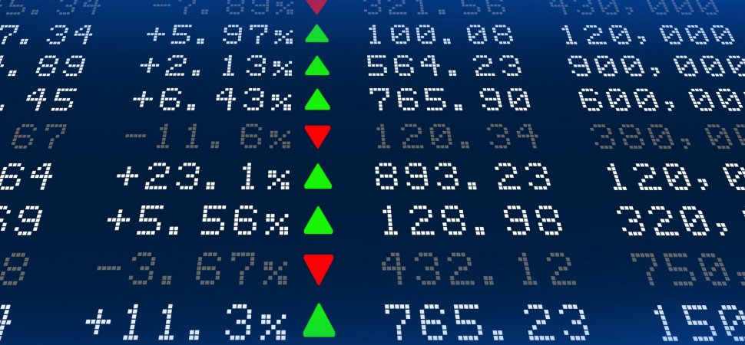
Sentiment analysis – stock market
Idea : it is believed that stock market investments are widely driven by people’s opinion and sentiment about a company. Since investments are subject to market risks and uncertainties, people usually think twice before investing, and only do so, when they’re confident of recovering the money they spent, along with desired returns. Keeping this in mind, the overall sentiment in the stock market about a company, whether to invest in its shares, or sell it, can possibly reveal signals about the company’s fate. If people sense a potential misconduct on the part of the company, which can eventually lead to a downfall in the company’s share, they would refrain from any stock activity related to that company. This can be a part of our overall model to predict loan default as a validator for for the other variables. However we can’t use it as a powerful predictor, as stock markets fluctuate for a variety of reasons, and not only due to financial misconduct.

Slide 8
Rating agencies
There are various Rating agencies that give valuable information about company financials and their regular records. Such agencies come up with ratings that relate to credit, debt, investments and other financial instruments that govern the way a company is performing and how it will perform over the year.
These ratings, whether negative or positive, directly impact the probability of default for any company.
The idea is to incorporate the insights from these ratings in order to come up with better results and more accurate predictions.
Ratings that we plan on covering for the prototype are as follows.
CRISIL: Comes up with Business Standards and rates the entire gamut of debt instruments of a SME
FITCH: One of the nationally recognised statistical rating organizations that comes up with Credit ratings of the company
ICRA: Indian independent and professional investment information and credit rating agency
Rating Agencies
CRISIL
ICRA
FITCH

Slide 9
Company Financials
One of the most accurate indicator about a company’s financial health is the company’s financial report. This method can only be applied to publicly listed companies, however as a bank extending credit, financial information should be easily available.
Altman Z Score The Altman Z-score is the output of a credit-strength test that gauges a publicly traded manufacturing company's likelihood of bankruptcy. The Altman Z-score is based on five financial ratios that can calculate from data found on a company's annual 10-K report. It uses profitability, leverage, liquidity, solvency and activity to predict whether a company has high probability of being insolvent. Z-Score = 1.2A + 1.4B + 3.3C + 0.6D + 1.0E A = working capital / total assets B = retained earnings / total assets C = earnings before interest and tax / total assets D = market value of equity / total liabilities E = sales / total assets A score below 1.8 means it's likely the company is headed for bankruptcy, while companies with scores above 3 are not likely to go bankrupt. |  | Beneish Model The Beneish model is a statistical model that uses financial ratios calculated with accounting data of a specific company in order to check if it is likely (high probability) that the reported earnings of the company have been manipulated. 1.DSRI - Days' sales in receivable index 2. GMI - Gross margin index 3. AQI - Asset quality index 4. SGI - Sales growth index 5. DEPI - Depreciation index 6. SGAI - Sales and general and administrative expenses index 7. LVGI - Leverage index 8. TATA - Total accruals to total assets Once calculated, the eight variables are combined to achieve an M-Score for the company. An M-Score of less than -2.22 suggests that the company will not be a manipulator. An M-Score of greater than -2.22 signals that the company is likely to be a manipulator
The following models can be used to assess the bank’s ability to pay back on a loan, by checking its financial status, and can also determine if a company is manipulating its financial books in order to hide the possibility of a potential default. The outcomes of these models can help determine the company’s probability to default.

Slide 10
Company’s business network analysis
Business Network
Overall Industry
Competitor
Buyer
Supplier
To analyse a company’s business network, there exists a need to analyse the various stakeholders of the company which includes suppliers, client/buyers, competitors and the industry in which it resides.
The idea is to not just look for the previously defined indicators but also analyse the company’s network as an anomaly in one stakeholder will leave a trail/ impact on its others stakeholders or financial records thereby creating a network effect throughout the company records.
This network effect can help us identify huge transaction anomalies and can raise alarm for defaults that happen within the company regularly.

Slide 11
THANK YOU

